Slide 1
Determination of Likelihood of Purchase in Online Shopping
Presented By: Ambar Ghosh
Ankita Deore
Niveditha Ramayanam
Prahlad Agnihotri
Pratik Nag
Project Mentor: Mr P.V.Subramanian

Slide 2
Table of Content :
Introduction
Scope & objective
Datasets
EDA for the given dataset

Slide 3
Introduction:
Nowadays, online shopping has become a very common scenario.
There are many shopping websites offering a wide range of goods for people.
Many users who browse through various websites but probability of purchasing a product is very low.
There are quite a number of factors influencing the likelihood of purchasing a product from any shopping website.

Slide 4
Scope & Objectives:
Objective:-
Exploration of the given dataset performing an exploratory data analysis for the getting an idea about the likelihood of purchasing a product online and studying the influence on the sales figures.
Scope:-
The main scope of the project is to get a decent insight knowing more about the likelihood of purchasing a product thus understanding the features effectively, which influence the sales.

Slide 5
Datasets
Preparation of Dataset:-
Formatting the dataset:
Reducing the data:
Data Cleaning:
Decomposing the Data:
Rescaling the Data:

Slide 6
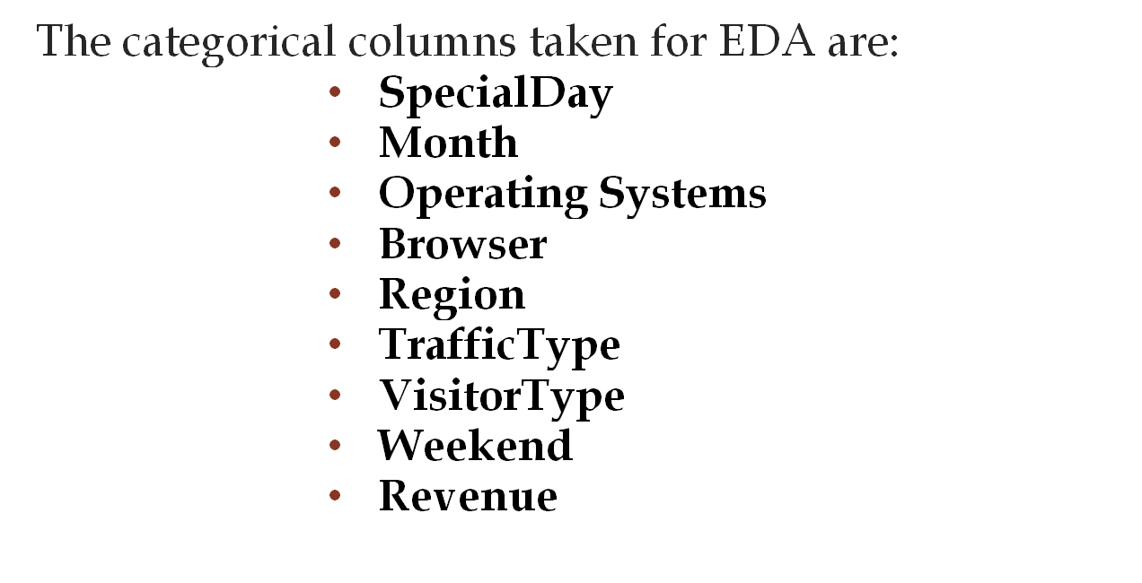
Categorical Values

Slide 7
Let’s have a brief of all the categorical features:
Special Day: It basically refers to all the special occasions be it Diwali or Holi or
Valentine’s day...
Month : It specifies month of the year whenever a customers visits a website irrespective of their conversion rates into making a purchase.
Operating Systems: It gives us a bit more clarity on which operating system is used by the customer whenever they visit the website.
Browser: Tells us which browser is most preferred by the customer for surfing.
Region: Tells us exactly from which region the customer is accessing the website.
.

Slide 8
Let’s have a brief of all the categorical features:
Traffic type: Basically, it tells us from which source the customer is visiting the website be it some social media, adds or some other sources.
Visitor type: Categorises if the visitor surfing the website is a new visitor, returning visitor and others
Weekend: It mentions if the online shopping website is accessed by customer on weekends or weekdays .
Revenue: It is being used as the target variable for this capstone project which tells us if a customer is giving profit to the company or not indirectly it gives us a fair enough idea about the likelihood or probability of purchase of any product from the website.

Slide 9
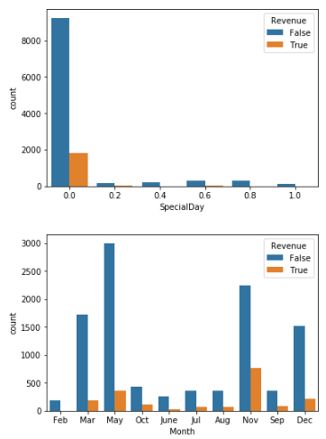
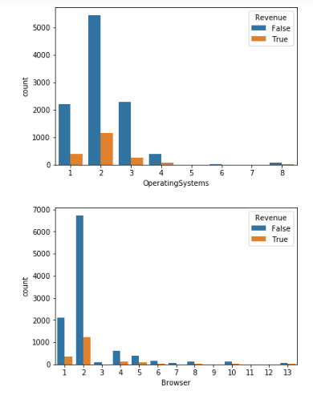
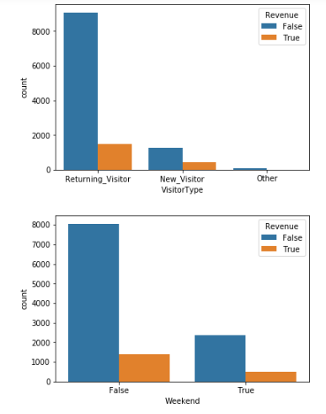
Categorical values EDA:

Slide 10
Insights:
There is more information on special day ‘0’ compared to other special days.
Interestingly the revenue is achieved on weekdays than on a weekend
The inflow of new visitors is very less. The Business needs to focus on getting more customers to the website.
Operating System 2 is somehow bringing more revenue!! which is interesting.
We did a factor plot and count plot on these columns for getting an idea.

Slide 11
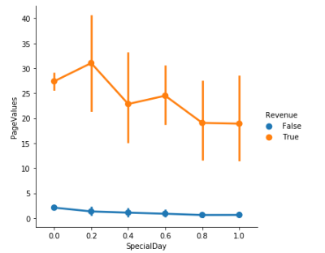
Factorial Plot
Insight:
From above figure, it is clear that on special days the page values are high!! and there is more scope to achieve revenue if some discounts are offered on the products using recommendation systems.

Slide 12
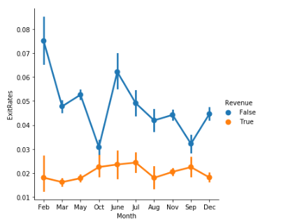
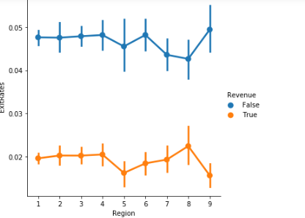
Factorial Plots
Insight:
From the above plot, The Exit rates of the customers are high no matter what month or what region it is. Which means that the business is in loss. It has to reduce the exitrates of the customers to achieve more revenue.

Slide 13
One Hot Encoding and Label Encoding:
There are 10 numerical and 8 categorical variables in the given data.
Out of the 8 categorical variables 3(Weekend, Visitor Type and Month) are of either string or boolean data types.
Special day is an ordinal type of variable.So applying categorical on it
Since others are nominal variables we should one hot encode them to add equal weightage to every sub category present in it.

Slide 14
Uni & BiVariate Analysis on Numerical data
The numerical columns taken for EDA are:
1) Administrative
2) Administrative_duration
3) Informational
4) Informational_duration
5) Product Related
6) Product Related_Duration
7) Bounce Rates
8) ExitRates
9) Page Values

Slide 15
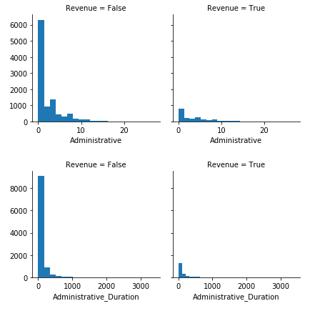
Distribution of each Continuous attribute with respect to the Target Variable
-

Slide 16
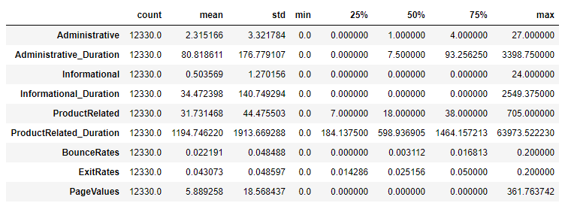
Descriptive Statistics

Slide 17
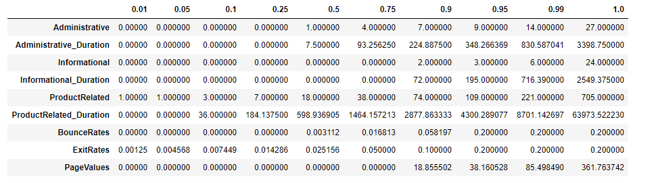
Outlier check: Quantile view

Slide 18
Feature Selection and Importance

Slide 19
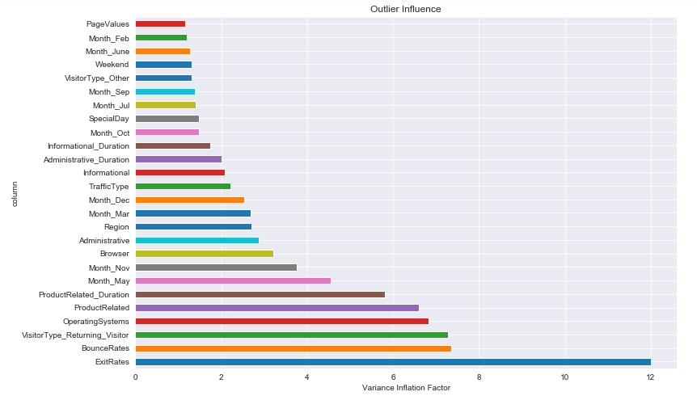
Variance Inflation Factor
Variance Inflation Factor to identify the multicollinearity among the variables

Slide 20
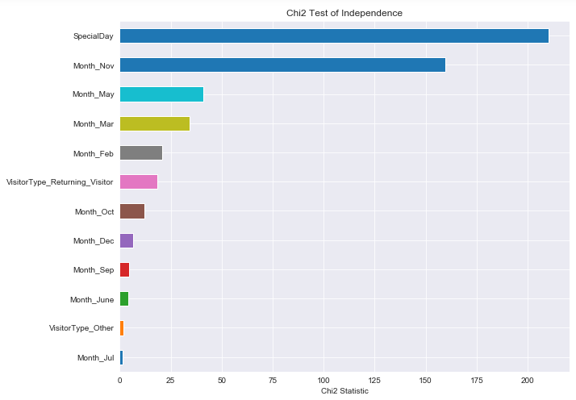
Chi2 Test of Independence
Performing chi2 Test for Target variable with respect to every Categorical Variable to identify the statistical significance of each variable.

Slide 21
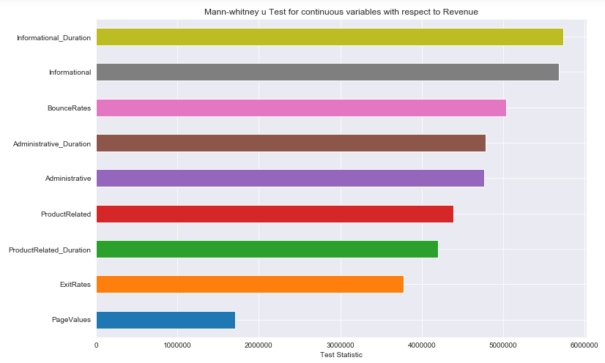
Mann-Whitney U Test For Continuous variables
Mann-Whitney U test is the non-parametric alternative test to the independent sample t-test.

Slide 22
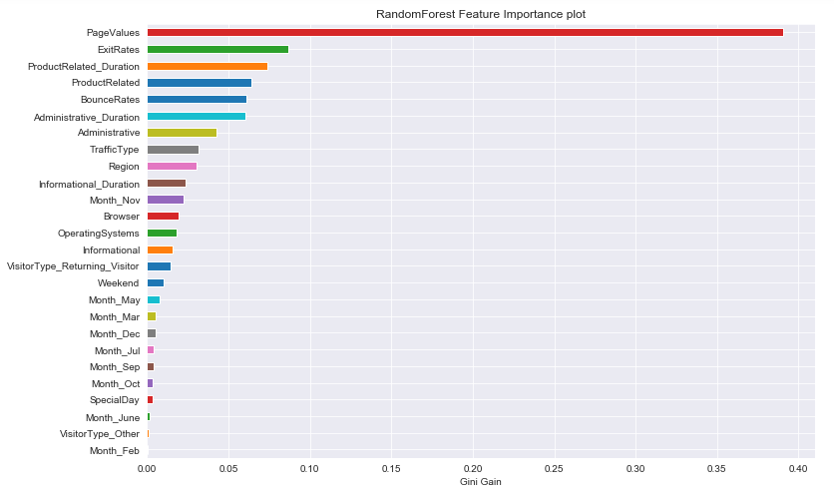
Feature Importance Plot using Gini Gain

Slide 23
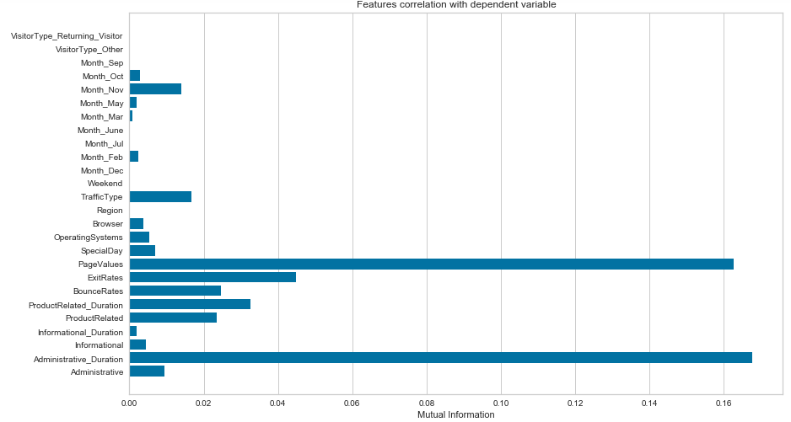
Mutual Information Classification Plot
The function relies on nonparametric methods based on entropy estimation from k-nearest neighbors distances

Slide 24
Model Building

Slide 25
Methods of assessing model performance
We have used two methods to cross validate the model performance.
  1. 70/30(80/20) split model
  2. K-fold cross validation(k=3,10)

Slide 26
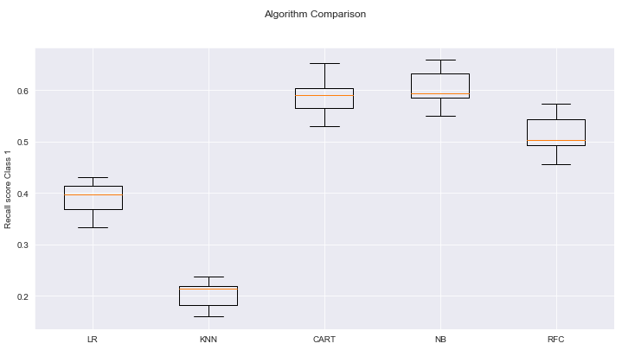
Base Model Check
Base Model Checking with both parametric and non parametric models.

Slide 27
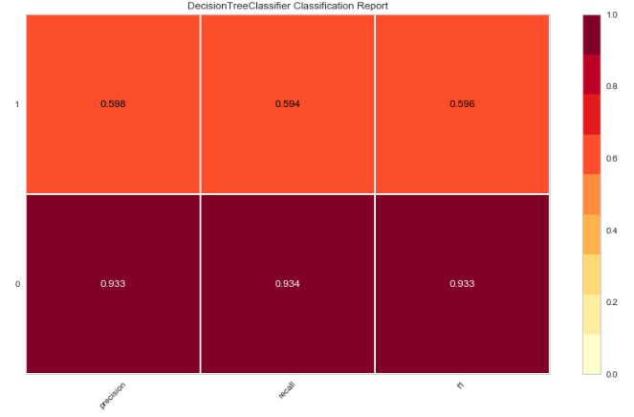
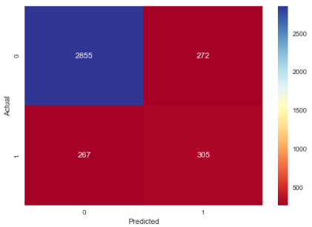
Decision Tree Model (CART)
Decision tree model can handle outliers but still outliers will affect it as it divides continuous variables on mean instead of median. However, we got much better results for decision tree than other predictive models.
FN: 267
Total 1: 572

Slide 28
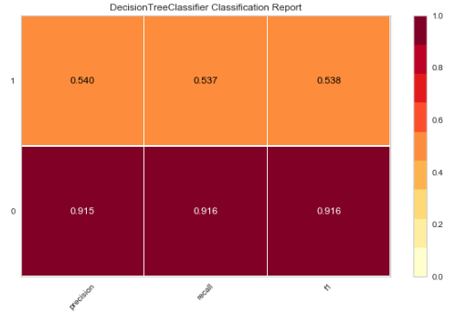
Classification Report for Decision Tree
Recall achieved for class ‘Revenue’: 0.537
f1 score achieved for class ‘Revenue’: 0.538

Slide 29
Random Forest-Feature selection & Hyper Parameter Tuning
Random Forest feature extraction(importance threshold of 0.01)
Administrative , Administrative_Duration , Informational, Informational_Duration , ProductRelated, ProductRelated_Duration, BounceRates , ExitRates, PageValues, OperatingSystems, Browser, Region, TrafficType, Weekend, Month_Nov, VisitorType_Returning_Visitor
Grid Search Cros Validation:
criterion='gini',max_depth=15,max_features=12,min_samples_leaf=12,min_samples_split=7

Slide 30
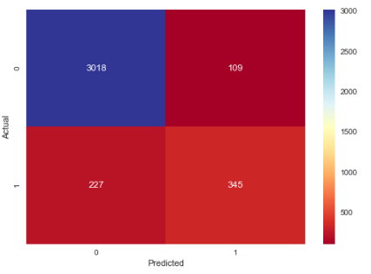
Model Performance
Confusion Matrix metric with Random Forest modelling with Hypertuned parameters.
FN: 227
Total: 572

Slide 31
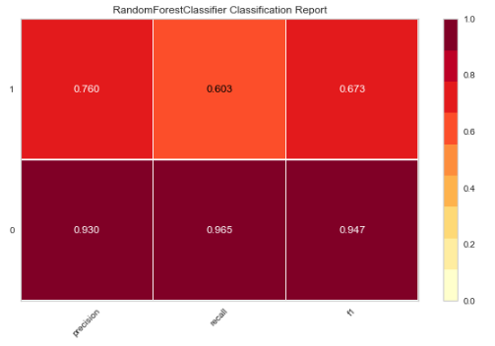
Random Forest - Classification Report
Recall achieved for class ‘Revenue’: 0.6
f1-score achieved for class ‘Revenue’: 0.67

Slide 32
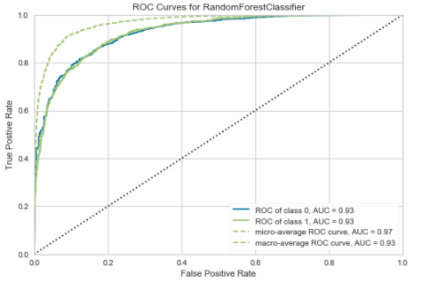
AUC – ROC
AUC - 0.93

Slide 33
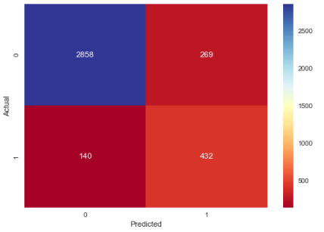
Random Forest - Threshold Change
Threshold - 0.3
FN:140

Slide 34
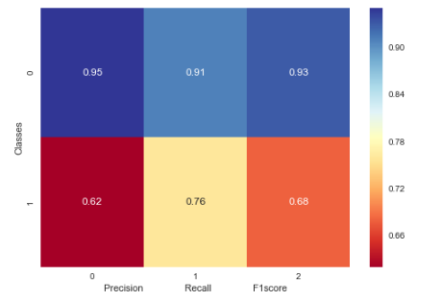
Random Forest - Threshold - Classification Report
Recall - 0.76
F1 score - 0.68

Slide 35
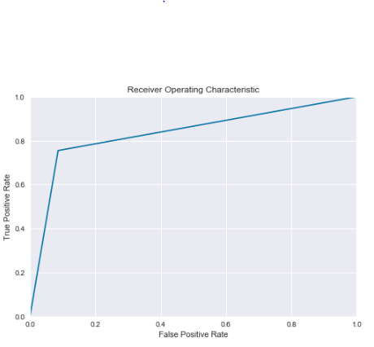
AUC – ROC after Threshold change
AUC = 0.84

Slide 36
Assumptions
VIF of 10 is assumed to be as no multicollinearity
Threshold of 0.3 is acceptable

Slide 37
Conclusion
The purpose of this project is to examine consumer behavior pattern toward online shopping and the possibility that the customer will buy the product. After analyzing the data, we have given insights and the pattern of customer behavior towards online shopping. In addition, we have used predictive models to predict the class (generates revenue or not). In addition, we got an accuracy of 91%, f1 score of 90%.

Slide 38
Referrences
https://www.researchgate.net/publication/324694092_EFFECTS_OF_ONLINE_SHOPPING_ON_CONSUMER_BUYING_BEHAVIOUR
• Chang, M., K., Cheung, W., Lai, V., S. (2005), 'Literature derived reference models for the adoption of online shopping', Information & Subject:capstone interim report Version 2.docxManagement, Vol.42(4), pp.543-559.
• E-commerce Facts (2012), 'Eurostat: 43 percent of Europeans make purchases online', [online] Available at: http://www.ecommercefacts.com/research/2012/05/eurostat-eu-online-shoppi/ [accessed on 10 December 2016]

